Slide 1
Dhamma.org/IVTA

Slide 2
GOAL
- Get involved & help get others involved*
- Get benefited & help get others benefited
- Get educated & help get others educated
To Continue the spread of Dhamma while preserving the purity

Slide 3
WHY DOES TECHNOLOGY MATTER?
Technology makes it easier to create different versions of - for example:
Media
AT Kits, AT directories
Application Forms, LC systems
Student-facing websites, Mobile apps
Technology admins might have access to sensitive student information
SCENARIOS THAT MIGHT LEAD TO IMPACTING THE EFFICACY OF THE TECHNIQUE

Slide 4
DO YOU KNOW?
What is Dhamma.org (IVTA)?
Where to find AT resources? Who to contact for help?
What are Dhamma.org mobile apps? How can I find, install and use them?
What is Portal? How is it different from DhammaReg / CALM / Dipi?
What services do VRI, Pariyatti and VCF offer?
What is Dhamma.org User Account?
What is M365 (dhamma.org email, Teams, OneDrive)?
What is Copyright vs Trademark? What is Privacy vs. Security?
What are AT email lists? What is Mediawalla / VCM / Desanā?
What are Goenka ji's guidelines on the role of technology?

Slide 5
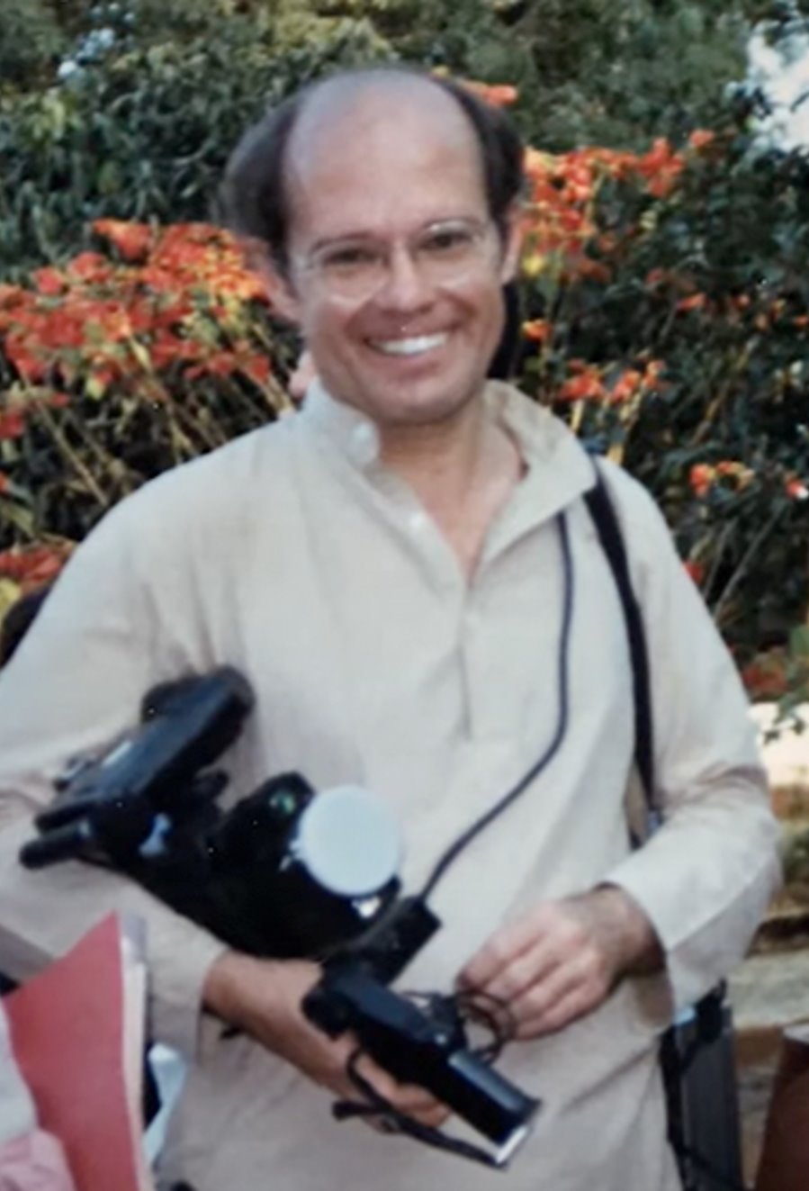
History
1990s, Goenkaji appoints Thomas Crisman as the teacher responsible for global information technology​
​
1995, www.dhamma.org is established as the international website to spread Dhamma around the world​
​
1995 to 2016 a dedicated team develops tools to support our tradition​
​
2017 Thomas invites an international team of Teachers to help

Slide 6
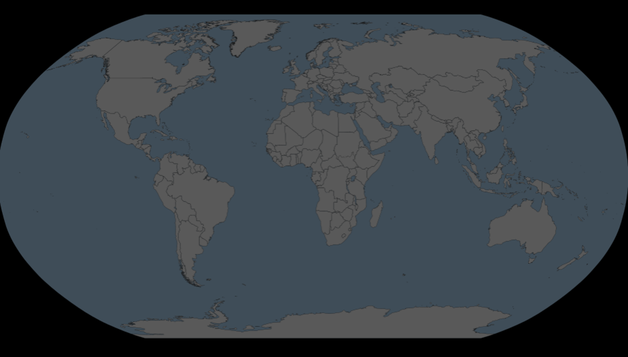
International Vipassana Technology Association (IVTA)
2017 IVTA was registered to manage dhamma.org like a center trust
2023 IVTA constitution is ratified to operate like a center trust & as a group of representative global AT/Ts with term limits
Directors / Trustees
Roy Menezes & Nancy Rosen, North America
Mirko Amon, Latin America
Andrea Mazza & Kevin Nash, Europe
Sabrina Katakam & Abhijit Bhabhe, India & South Asia
Sally McDonald, East Asia
Michael Barnes, Australia & New Zealand

Slide 7
DHAMMA.ORG TECHNOLOGY SOLUTIONS
INTERNATIONAL WEBSITES
MOBILE APPS (MAIN & CTC)
M365 INDIVIDUAL EMAIL & TEAM COLLABORATION TOOLS
MEDIA LIBRARY & MEDIAWALLA
COURSE SCHEDULES & ONLINE APPLICATIONS
LONG COURSE APPROVAL PROCESS
MAILING / ANNOUNCE LISTS
INTERNATIONAL SPECIAL LIST
AT & CCT BOOKS
DHAMMA.ORG PORTAL
CENTER OPERATIONS
INFRASTRUCTURE TOOLS: WIKI, JIRA, GITHUB, OTHERS

Slide 8
May all beings be happy!
🙏🙏🙏

